Slide 1
Climate and the Carbon Cycle: Digging into the details.
Presenters: Candace Dunlap, Kim Phillips, Jim Manley

Slide 2
Climate and the Carbon Cycle
Student pages
Climate and the Carbon Cycle
Teachers’ Guide Pages
http://serc.carleton.edu/eslabs/carbon/index.html
http://serc.carleton.edu/earthlabs/carbon/index.html

Slide 3
What Carbon Cycle?

Slide 4
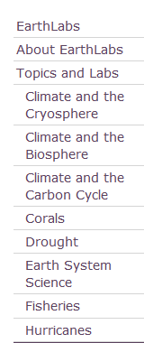
The Climate and the Carbon Cycle module is part of a larger set of of Earth science modules in the EarthLabs collection.

Slide 5
EarthLabs is a project of TERC, an independent, non-profit research and development group in Cambridge, MA.
Founded in 1965, TERC’s mission is to improve K-12 math and science education through research, teacher professional development, and curriculum development. (examples: EARTHLABS, EET, CLEAN)
www.terc.edu

Slide 6
Agenda
Introduction to EarthLabs module
Overview of the 8 labs in Climate and the Carbon Cycle module
NGSS alignment examples
Two mini-activities:
Connections Circle Game
Keeling Curve and Carbon Tracker graph analysis.

Slide 7
The module is composed of eight sections, called “Labs”
Learning activities are varied and include:
Hands-on experiments
Interactive visualizations
Videos
Data and graph analysis
Readings
Discussions
Case studies

Slide 8
Teacher pages

Slide 9
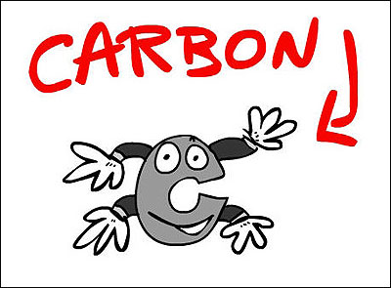
NGSS Crossing Cutting Concepts
Complex Systems
Causality
Patterns
Claim, evidence and argument
Scale

Slide 10
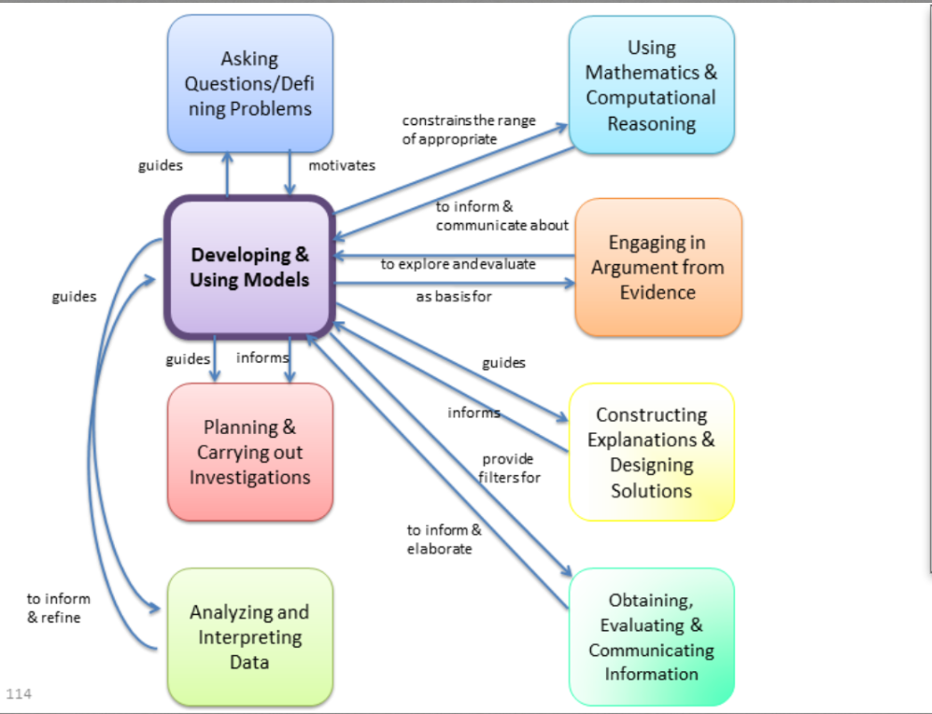

Slide 11
Sample NGSS alignment of DCIs, Crosscutting Concepts and Science and Engineering Practices
ESS2.D Changes in the atmosphere due to human activity have increased CO₂ concentrations and thus affects climate.
LS2.B Photosynthesis and cellular respiration are important components of the carbon cycle in which carbon is exchanged among the biosphere, atmosphere, oceans and geosphere through chemical, physical, geological and biological processes.
Analyze geoscience data to make the claim that increased CO₂ concentrations is caused primarily by the burning of fossil fuels (cause and effect)
Develop a model to illustrate role of photosynthesis and cellular respiration in the cycling of carbon among the biosphere, atmosphere, hydrosphere, and geosphere (LAB 2 (A,B) LAB 4B
LEARNING EXPERIENCES/ASSESSMENTS

Slide 12
Crosscutting Concept: Stability and Change Systems and Feedback
Analyze geoscience data to make the claim that one change to Earth’s surface can create feedbacks that cause changes to other Earth systems(i.e. changes in vegetation, changes in atmospheric CO₂ etc.) LAB 2B, 5B, 7A
CONNECTIONS GAME – LAB 2B
Create a model that illustrates feedback mechanisms in a pine bark beetle infestation of western forests - LAB 2B
ESS2-1 Earth’s systems, being dynamic and interacting, cause feedback effects that can increase or decrease the original changes.
LEARNING EXPERIENCES, ASSESSMENTS

Slide 13
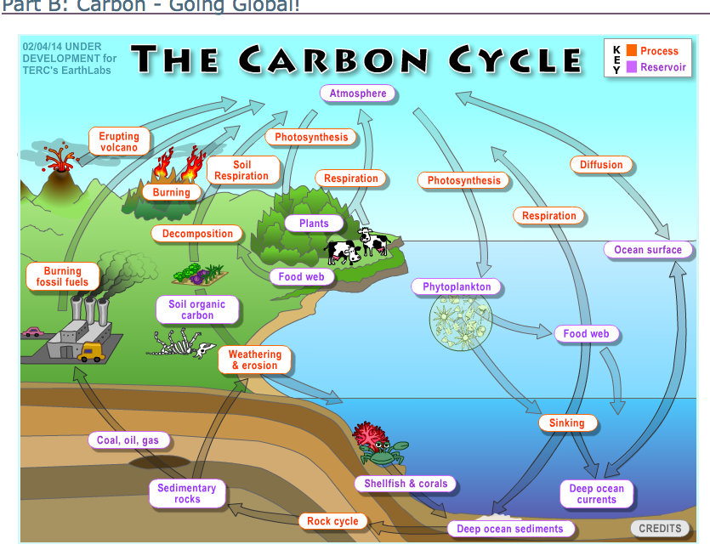

Slide 15
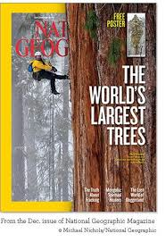
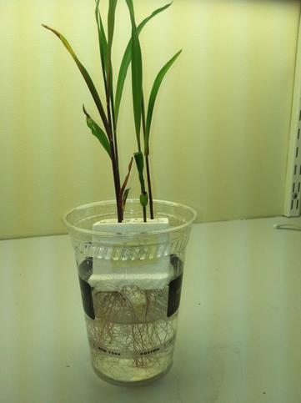
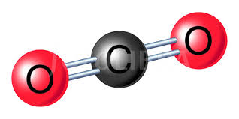
LAB 1A How do these redwood cone seeds grow into the world’s largest trees?
???????????????
Carbon in
Carbon out

Slide 16
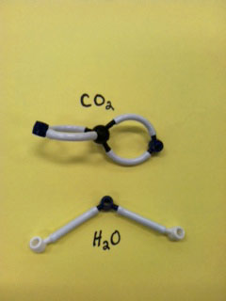
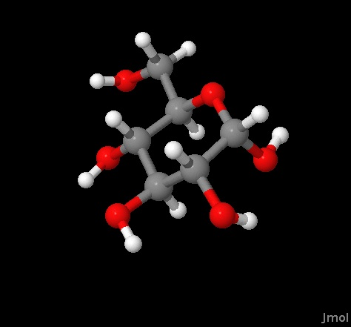
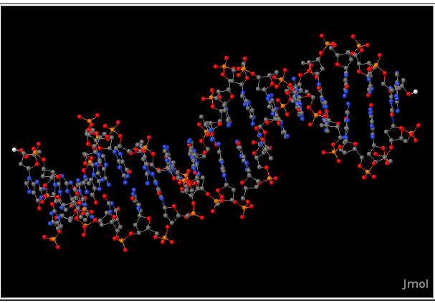
Digging Deeper – Lab 1B Building and visualizing biomolecules and biosphere processes
Photosynthesis
Cell Respiration
Biosynthesis!
DNA gets N, P, Mg and H atoms from soil. Where does it get its carbon atoms from?

Slide 17
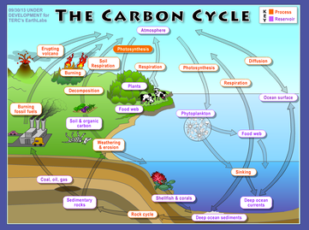
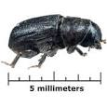
Lab 2: Carbon Cycle: Where does carbon go, how does it get there, how does it change, how long does it stay?
Terrestrial (Forest) Carbon Cycle Game (UCAR)
Global Carbon Cycle interactive
Identifying C.C. feedbacks using a Pine Bark Beetle case study
Regional, terrestrial
Global Spatial Scale
Time Scales
Behavior in complex systems

Slide 19
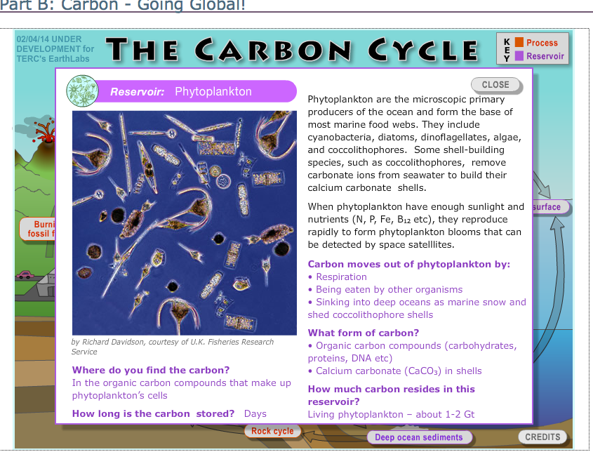

Slide 20
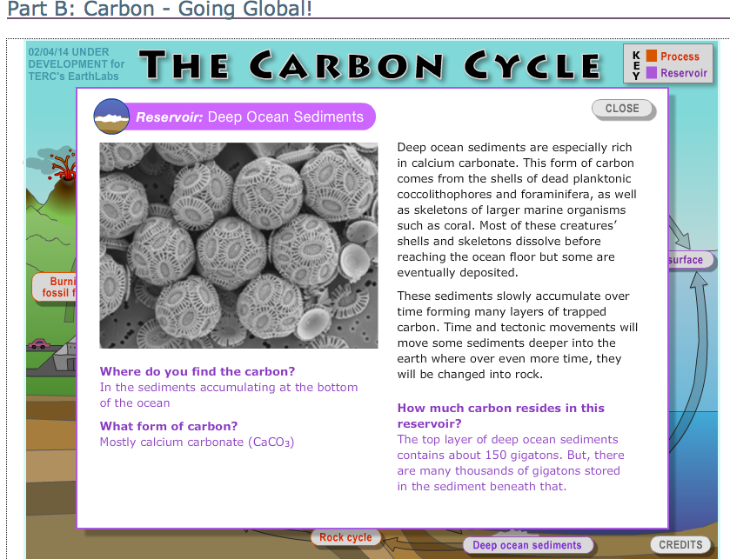

Slide 21
Connections Game: Modeling the Behavior of Complex Systems

Slide 22
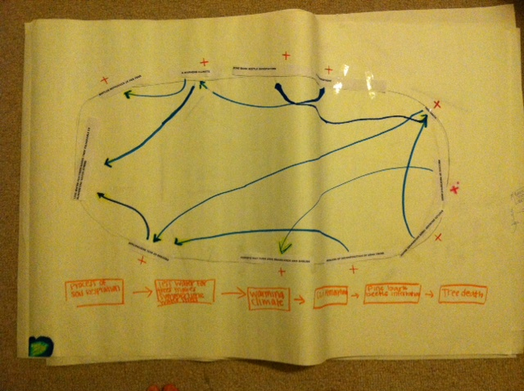
Identifying feedbacks

Slide 23
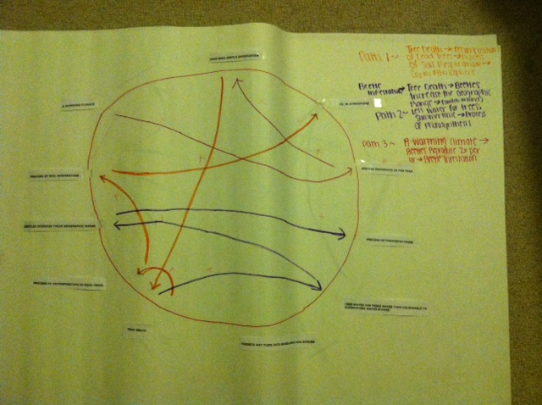

Slide 24
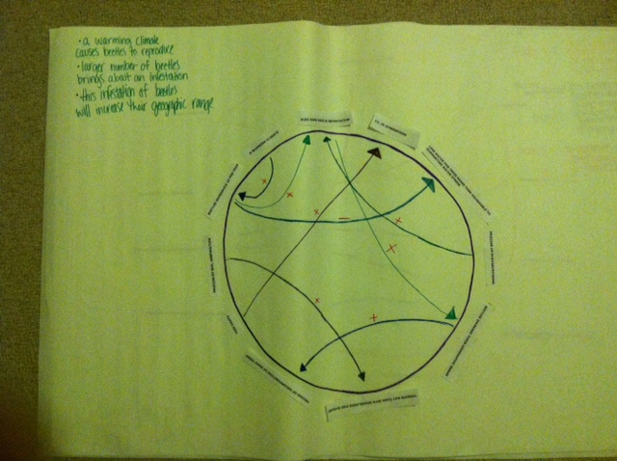

Slide 25
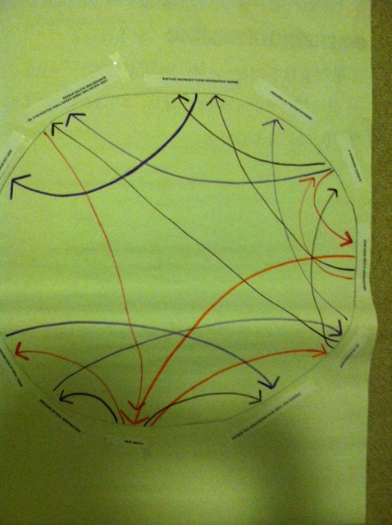

Slide 26
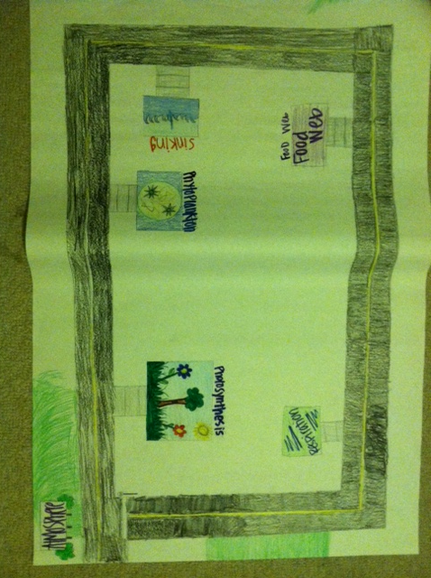

Slide 27
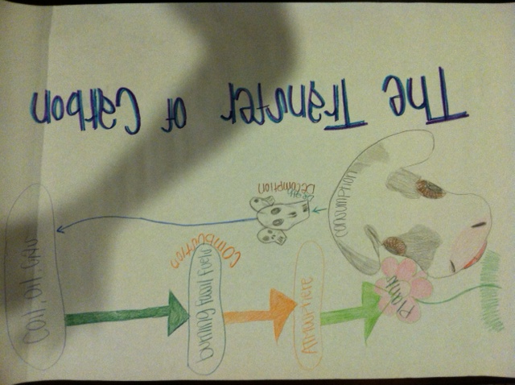

Slide 28
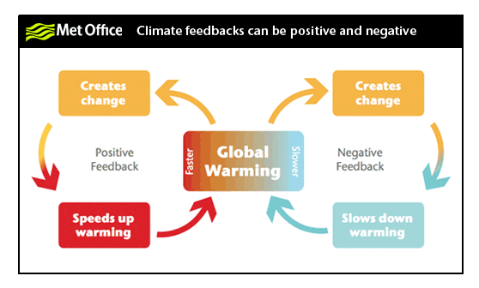

Slide 29
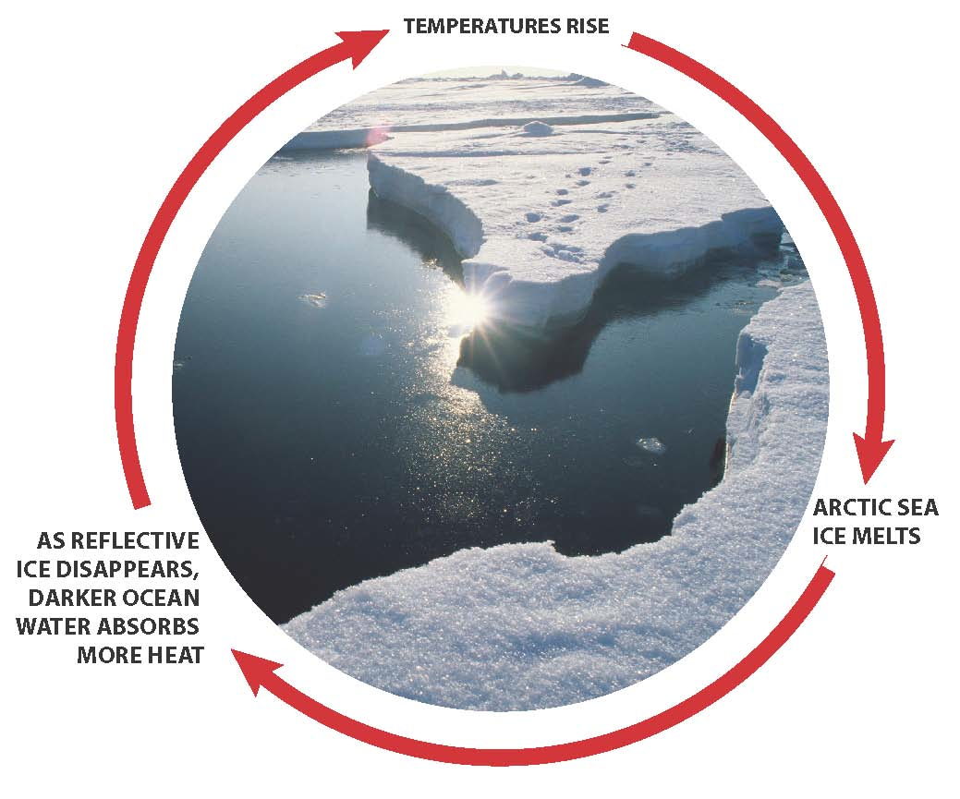
A feedback acts upon the original change to amplify it(reinforce) or dampen it.
Original Change

Slide 30
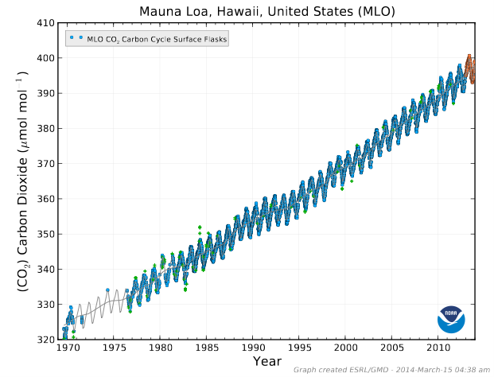
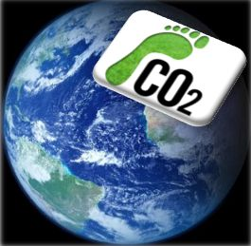
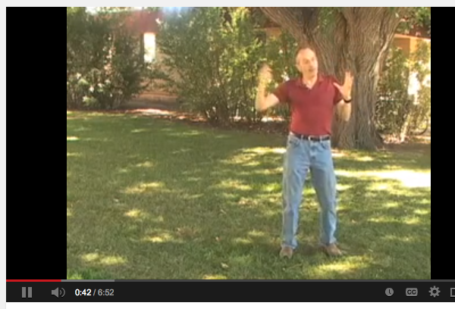
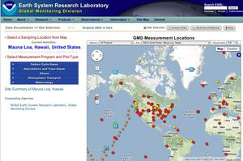
LAB 3- My Life as a greenhouse gas!

Slide 31
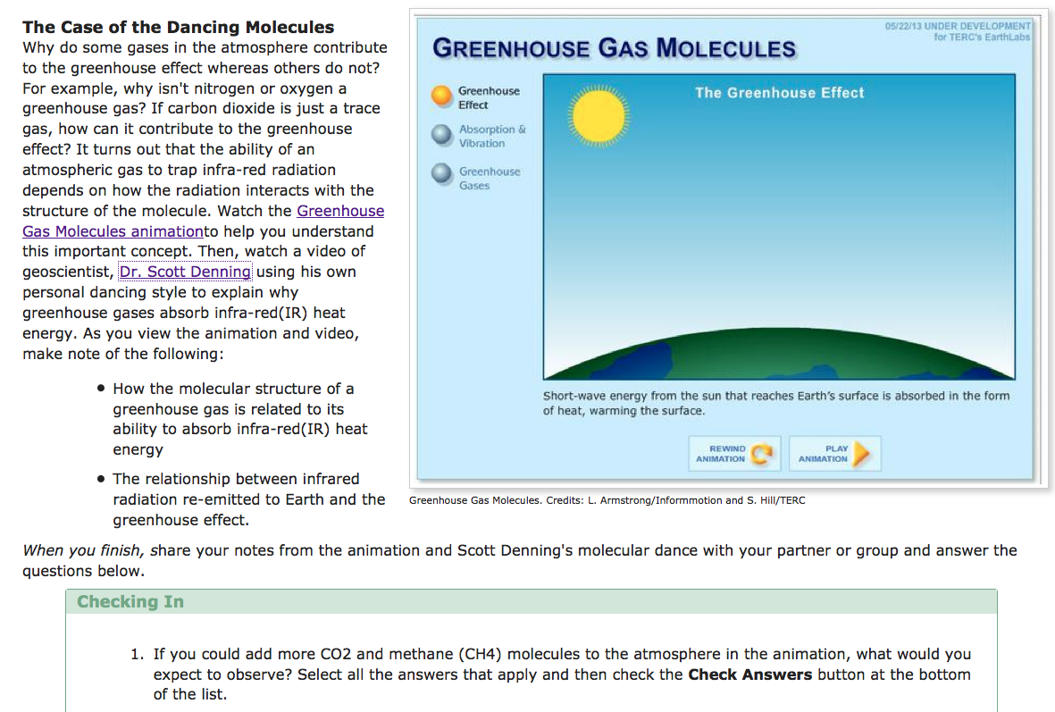
LAB 3A Why do greenhouse gas molecules absorb infrared but oxygen and nitrogen do not?

Slide 32
Carbon Tracker Activity : Competing claims- It’s us! It’s not us!

Slide 33
Keeling Curve (Lab 3B)
Keeling Curve
Source:NOAA

Slide 34
Mauna Loa –Time series

Slide 35
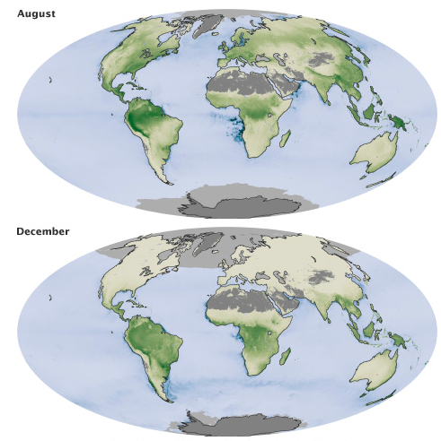
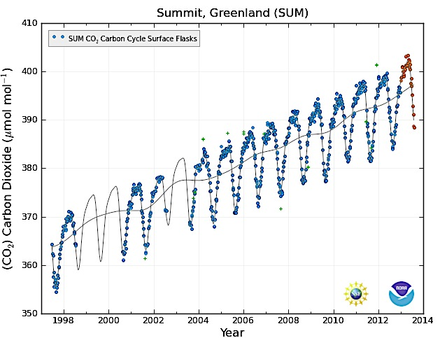
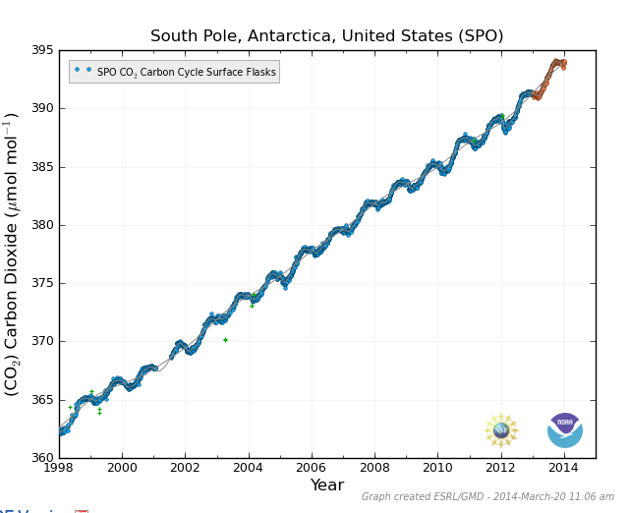

Slide 36
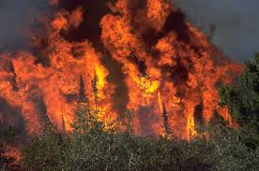
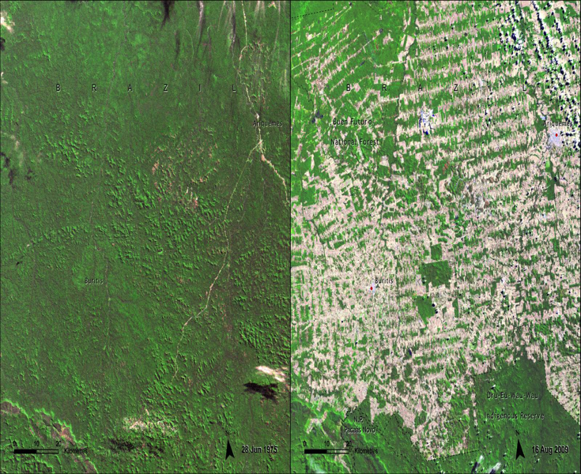
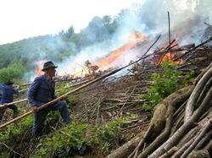
LAB 4 How do changes in the land affect the carbon cycle?
Wildfires
Deforestation
Solutions to Slash and Burn - mini case study
Global Forest Watch – Inquiry project
Case study: Ecological changes in a Boreal Forest

Slide 37
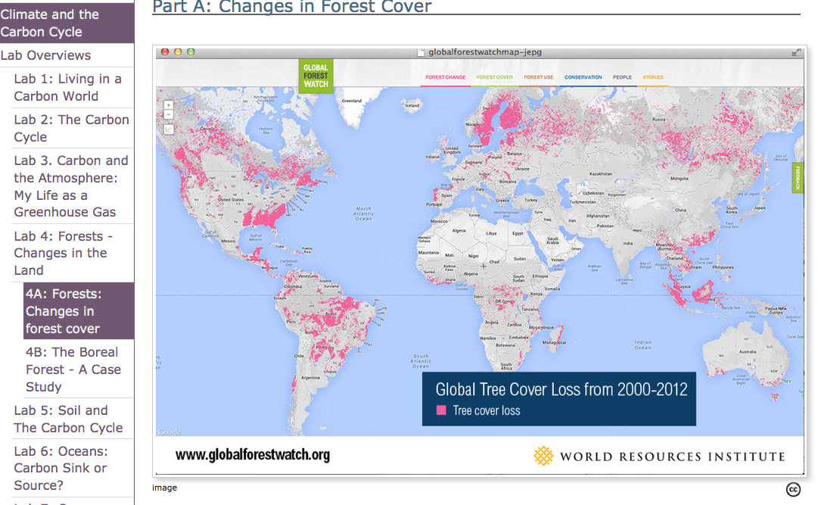

Slide 38
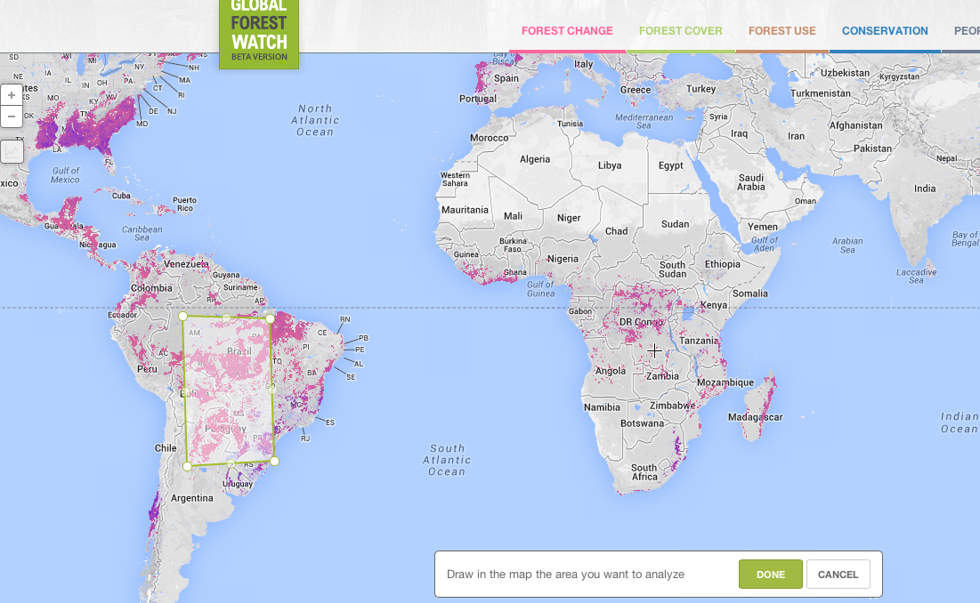

Slide 39
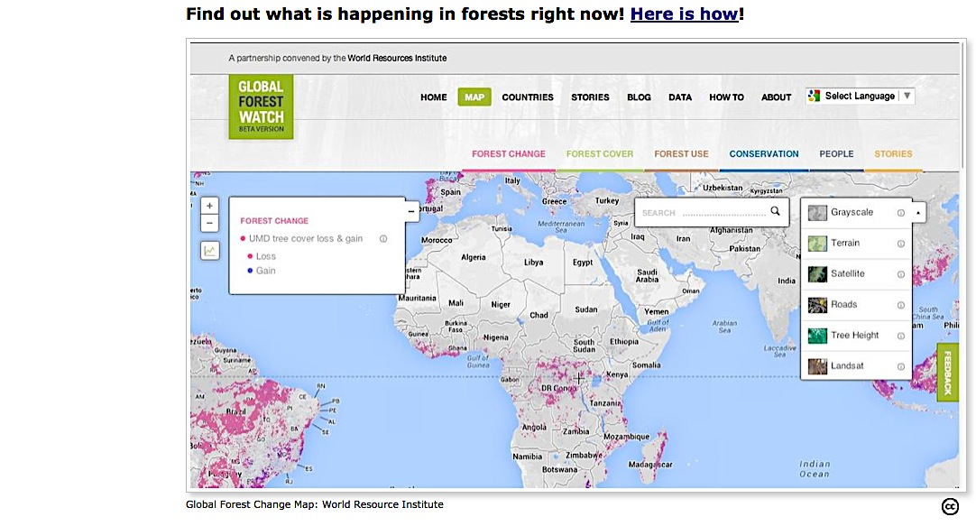
Notes:
Brand new forest change map
Can research different spatial scales of change – global, hemisphere, country, region, neighborhood
Many different variables to explore (

Slide 40
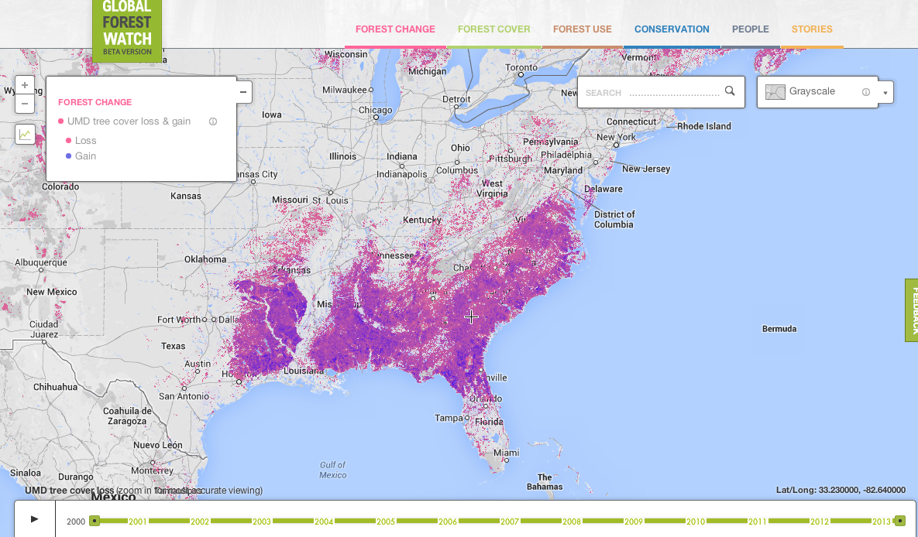

Slide 41
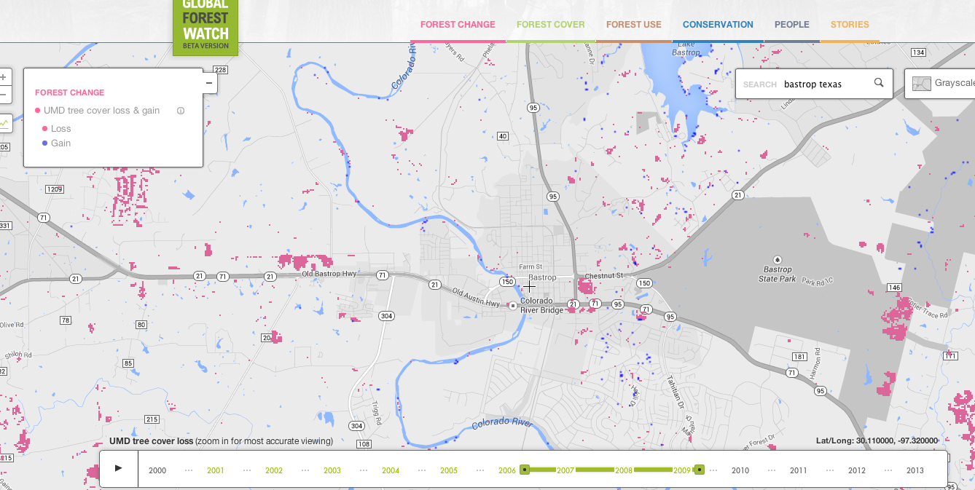

Slide 42
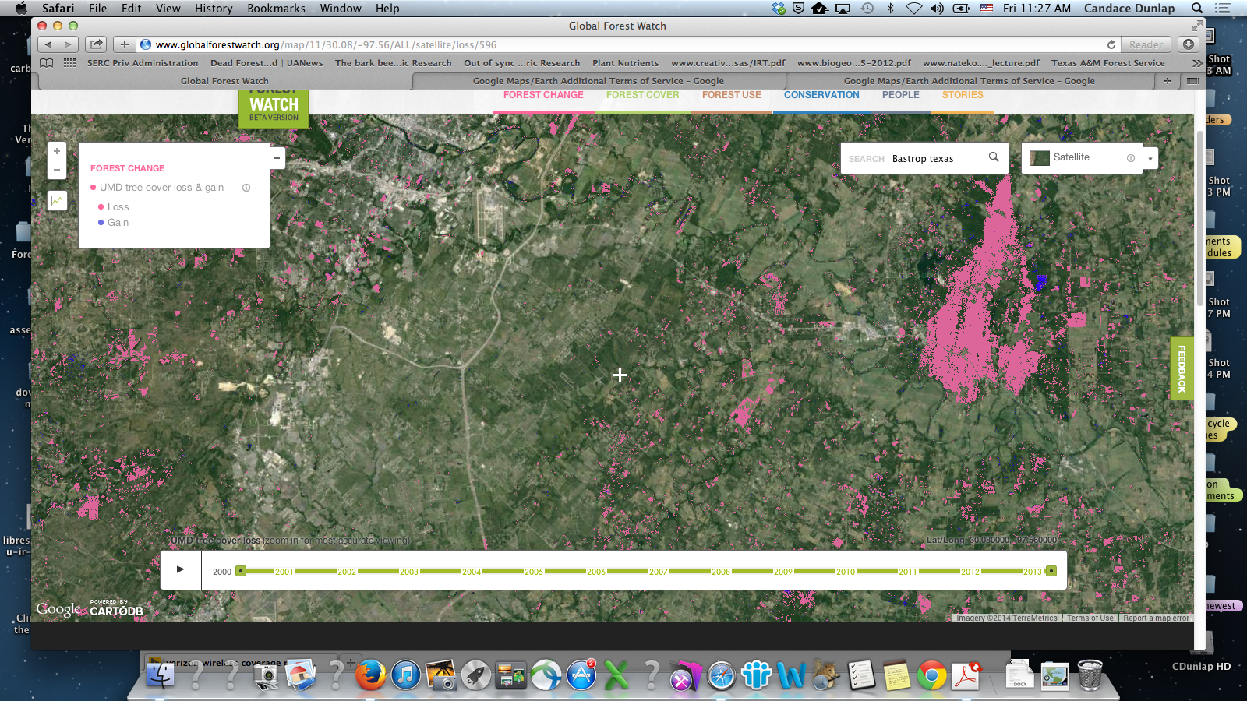

Slide 44
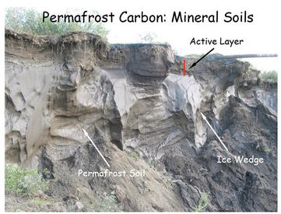
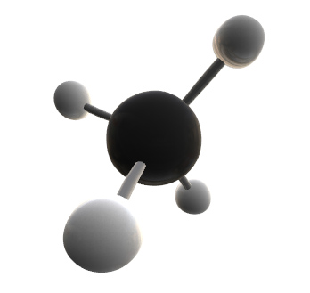
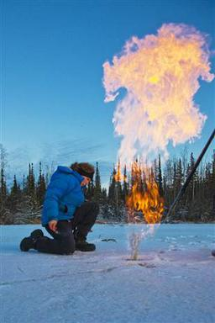
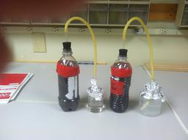
LAB 5 Soil and the Carbon Cycle

Slide 45
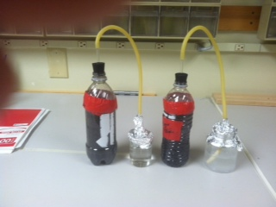
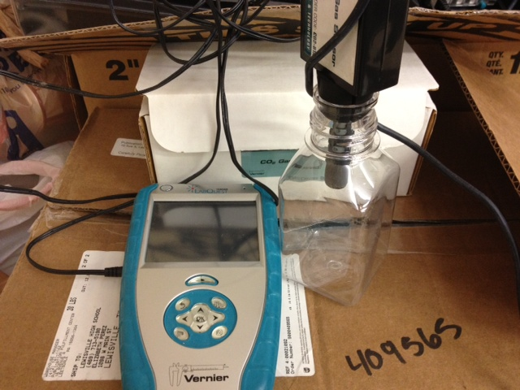
Soil Lab (Lab 5A)
Students will design and carry out an experiment testing one of the environmental variables that influence decomposition and soil respiration rates.

Slide 47
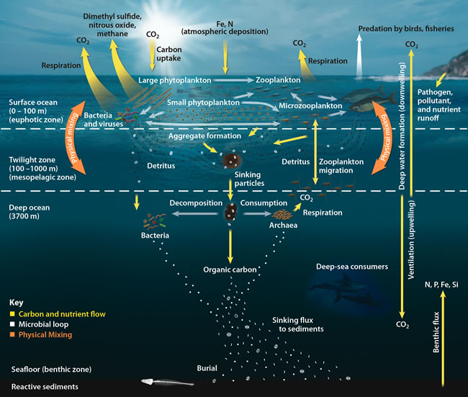
Lab 6 The ocean carbon cycle

Slide 48
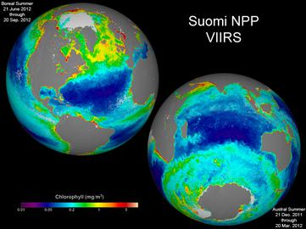
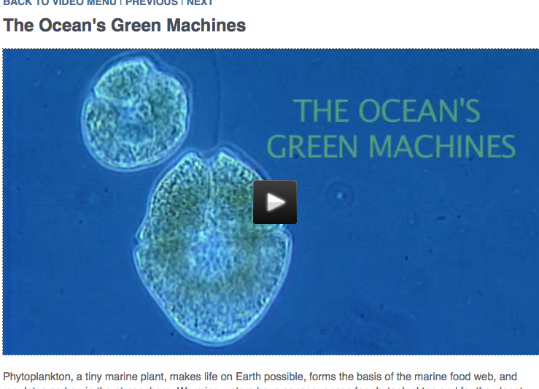
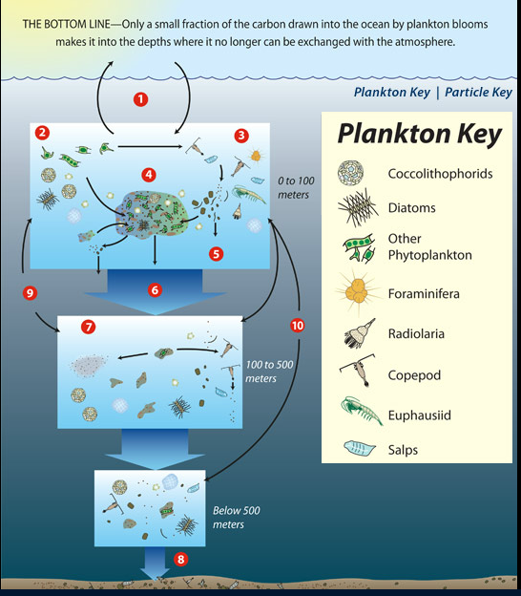
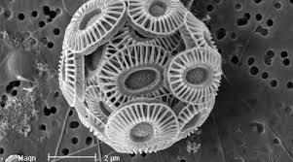
Lab 6 The ocean carbon cycle

Slide 49
Phytoplankton blooms Boreal Summer

Slide 50
Notes:
Pictures I took while on a research cruise with Dr. Maureen Conte off of the island of Bermuda. She is studying the changes in the amount of organic debris falling though the water column.

Slide 51
Lab 7 Ocean Acidification

Slide 52
Lab 7 Ocean Acidification -
pH scale
0
1
2
3
4
5
6
7
8
9
10
11
12
13
14
Acidic
Alkaline
Surface seawater
Predicted for 2100 under ‘business as usual’
Pre-industrial
From Turley & Findlay (2009)
Present day
pH scale for maps
Notes:
PPTX slide Credit goes to Dr. Gretchen Hofman, Scientist. This is the link to her webinar on the CLEAN collection of climate resources http://cleanet.org/clean/community/webinars/IW7.html
There is also a link to this webinar on the Teacher pages for Lab 7 “Ocean Acidification” Climate and the Carbon Cycle http://serc.carleton.edu/earthlabs/carbon/lab_7.html

Slide 53
Lab 7 B VirtualUrchin

Slide 54
Balancing the carbon cycle: Finding solutions with design and technology

Slide 56
What Carbon Cycle?

Slide 57
THANKS!
Thanks for joining us!
The urls for the Teachers’ Guide and the Student pages are on the Earthlab bookmarks

Slide 58
Climate and the Carbon Cycle
Student pages
Climate and the Carbon Cycle
Teachers’ Guide Pages
http://serc.carleton.edu/eslabs/carbon/index.html
http://serc.carleton.edu/earthlabs/carbon/index.html

